Slide 1
Council of Technical Groups (COTG) 2022 Business Meeting

Slide 2
Agenda
Introductions
Financials
Information Resources
Annual Meeting Feedback
Student Travel Awards
Standards Implementation Task Force
Revision of TG Handbook
Overview of Changes
Discussion (membership engagement)
Review of TG Health
Overview
Discussion

Slide 3
Introductions
COTG Chair (outgoing): Matthew Bolton mbolton@buffalo.edu
COTG Chair-Elect (outgoing, incoming COTG Chair): Tamsyn Edwards tamsyn@uber.com
COTG Chair-Elect (incoming Chair-Elect):
Robert Gutzwiller rgutzwil@asu.edu
Executive Director:
Steven Kemp skemp@hfes.org
Operations Senior Coordinator:
Caitlin Sarlo csarlo@hfes.org
TG Chairs / Representatives

Slide 4
Financials

Slide 5
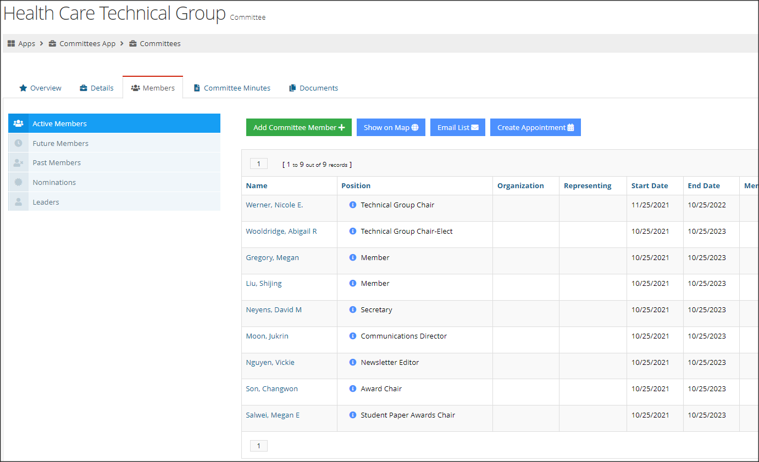
Information Resources

Slide 6
2022 Annual Meeting Feedback

Slide 7
Student Travel Awards
In previous years we recommended that student travel award decisions be made by a more appropriate HFES unit.
They are now being evaluated by the Student Chapter Committee
12 grants were awarded:
6 to first time attendees
6 to student presenters

Slide 8
Standards Implementation Task Force
Attempt to understand how easily it is for different researchers to identify standards (encourage reference to standards in publications)
Asked TG representatives to:
Find at least two papers (one TG-relevant one not)
Find relevant standards (standards, best practices, guidelines, etc.)
Document the standards found for each paper
Results: 8 TGs participated, 16 papers were submitted, Paul Green’s report was submitted for consideration

Slide 9
Revision of the TG Handbook
Attempt to modernize the TG Handbook
Major changes:
Simplifies COTG committee requirements
Removes newsletter requirements and establish official communications using the communities or other electronics resources
Provide a list of activities to help TGs engage with membership
Revise TG membership requirements from 150 to 75
Handbook

Slide 10
Revision of the TG Handbook
TG Requirements:
Have 75 members (more on this later)
Hold an annual business meeting
Have (at least) the following officers (2 year appointments, must be full HFES members):
TG chair
Program chair
Program chair-elect
Hold elections at least every 2-years
Have a transition plan and archives
Communications:
Annual Financial Report
Annual Activities report
Biannual communications:
News and updates on TG finances and activities
Optionally, contain a Chair’s Address
Can be used for the reports above
Refereeing papers in its field for the annual meeting
Have at least one session at the annual meeting

Slide 11
TG Membership
75 Minimum
150 Minimum

Slide 12
Revision of the TG Handbook
Optional (but good) things:
Officers:
TG Chair-Elect
Secretary-Treasurer
Electronic Communications Chair
Activities:
Conferences
Special annual meeting programs
Membership surveys
Membership drives
Developing Publications and Webinars
Awards: Total budget < $599 per award
Notes:
Conferences
Special annual meeting programs:
panels, demos, mock trials, invited addresses or speakers, etc.
Membership surveys: can reveal initiatives of interest to members
Membership drives: use the communities or more contact outreach through staff or other professional societies to recruit membership
Developing Publications and Webinars
Awards: Total budget for a TG award < $599 (includes costs of certificate or plaque, award administration costs, and monetary award)

Slide 13
Discussion: TG Membership Engagement

Slide 14
Review of TG Health
Internal Affairs
Problem
Lack of activity/responsiveness in some TGs
Many TGs not making membership threshold (previously 150)
Investigation
Conducted survey of TG activities
Gathered membership numbers
Computed shared membership values
Included incidents that arose with TGs over the last year

Slide 15
Review of TG Health
Internal Affairs
Conclusions
There are varying levels of activity across TGs regardless of size
Some TGs appear to need help engaging membership or finding people interested in being officers
Possible Recommendation
Encourage more active membership (previous discussion)
Specific TG intervention by the COTG
Merge TGs to combine their strengths and avoid small memberships*

Slide 16
Review of TG Health
Internal Affairs
Children’s Issues ⟡ Environmental Design ⟡ Macro Ergonomics
New TG size: 149
Communications ⟡ Internet ⟡ Computer Systems
New TG size:135
Usability and Systems Evaluation ⟡ System Development
New TG size: 281
Individual Differences in Performance ⟡ Perception and Performance
New TG size: 241
Proposed Mergers

Slide 17
Review of TG Health
Internal Affairs
Discussion

Slide 18
Contacts
COTG Chair (outgoing): Matthew Bolton mbolton@buffalo.edu
COTG Chair-Elect (outgoing, incoming COTG Chair): Tamsyn Edwards tamsyn@uber.com
COTG Chair-Elect (incoming Chair-Elect):
Robert Gutzwiller rgutzwil@asu.edu
Executive Director:
Steven Kemp skemp@hfes.org
Operations Senior Coordinator:
Caitlin Sarlo csarlo@hfes.org

Slide 19
Backup slides

Slide 20
Shared Membership

Slide 21
Annual Meeting Submissions
 | 2019 | 2020 | 2021 | 2022
Aerospace Systems | 19 | 27 | 12 | 22
Aging | 22 | 16 | 15 | 13
Augmented Cognition | 15 | 10 | 8 | 6
Children's Issues | 6 | 5 | 2 | 2
Cognitive Engineering & Decision Making | 89 | 63 | 40 | 57
Communications | 5 | 5 | 7 | 8
Computer Systems | 15 | 13 | 5 | 7
Cybersecurity | 14 | 21 | 13 | 21
Education | 12 | 21 | 15 | 22
Environmental Design | 7 | 8 | 7 | 8
Forensics Professional | 15 | 8 | 6 | 5
General Sessions | 19 | 15 | 14 | 27
Health Care | 70 | 79 | 47 | 63
Human AI Robot Teaming |  | 24 | 40 | 54
Human Performance Modeling | 17 | 13 | 17 | 16
Individual Differences in Performance | 18 | 12 | 14 | 14
Internet | 6 | 4 | 4 | 5
Macroergonomics | 17 | 13 | 4 | 6
Occupational Ergonomics | 81 | 52 | 40 | 35
Perception and Performance | 31 | 38 | 27 | 30
Product Design | 20 | 28 | 18 | 12
Safety | 34 | 35 | 21 | 19
Student Forum |  | 25 | 17 | 33
Surface Transportation | 66 | 59 | 44 | 57
System Development | 9 | 9 | 8 | 10
Training | 19 | 13 | 17 | 13
Usability and System Evaluation | 44 | 35 | 21 | 25
Virtual Environments | 28 | 30 | 24 | 24
Workshops |  |  | 7 | 8
TOTAL | 698 | 681 | 514 | 622

Slide 22
Financials

Slide 23
A simple majority of those COTG members voting will be used to approve or disapprove items other than technical group formation and dissolution, which require a two-thirds majority as specified in Section 16.6 and Section 16.7.
…
of the membership of a technical group through its officers, on the recommendation of a two-thirds majority of the COTG, or on its own initiative, Executive Council may dissolve any technical group. In the latter case, it is expected that Executive Council will solicit and consider the recommendation of the COTG before taking action, and that any action will be for cause. Cause may be the repeated failure of a technical group to meet the requirements specified in Section 16.2 or Section 16.3

